Slide 1
Preparing for SM&CR in the Insurance Sector
Senior Managers and Certification Regime

Slide 2
Learning objectives
Background
Senior Managers Regime
Certification Regime
Conduct Rules – Individual
Conduct Rules – Senior Managers
Implementation

Slide 3
Parliamentary Commission on Banking Standards
Established in June 2012 to consider the professional standards and culture of the UK banking sector following the 2007-2008 financial crisis.
PCBS recommended a new regulatory framework to:
• focus accountability on a narrower number of the most senior individuals; • encourage individuals to take greater responsibility for their actions; and • make it easier for firms and regulators to hold individuals to account.
July 2013 Government endorsed findings and confirmed it would implement PCBS’ main recommendations.

Slide 4
Timeline
October 2015
7 March 2016
10 Dec 2018
9 Dec 2019
HM Treasury announce that all regulated firms will be subject to SM&CR
SM&CR commenced for banks, building societies and PRA designated investment firms.
SIMR replaced the Approved Persons regime for dual-regulated insurance firms
Extension of SM&CR to Insurers (replacing APR and SIMR)
Extension of SM&CR to all financial services firms

Slide 5
Opinion: What do you think?
Why is SM&CR being extended to all insurance firms?

Slide 6
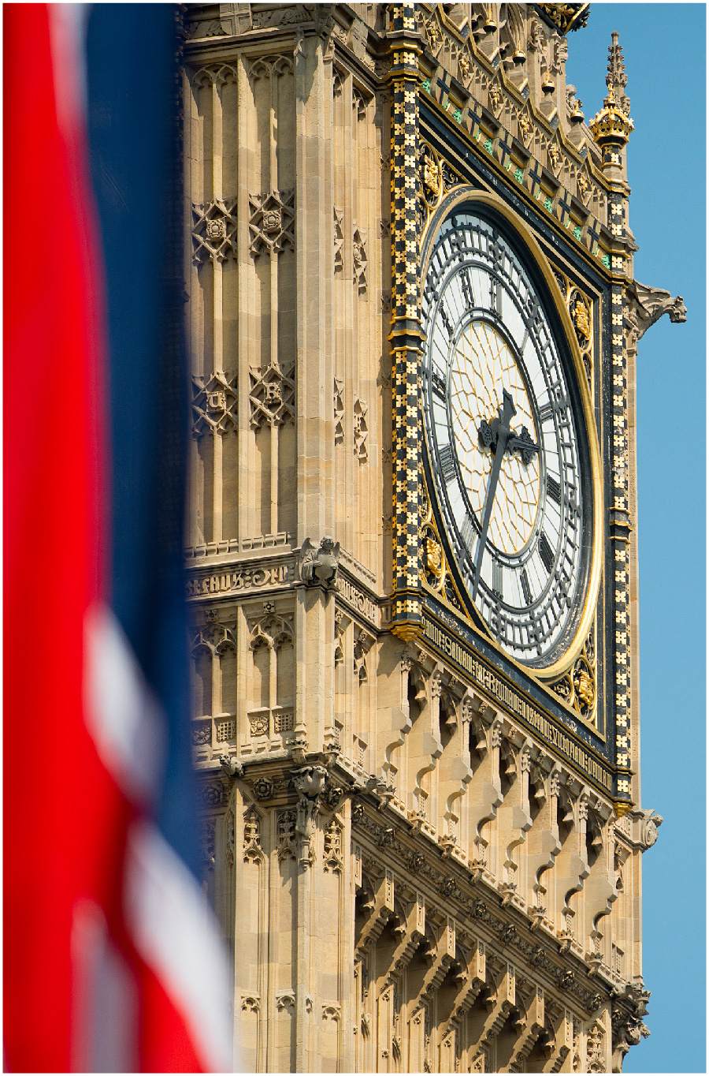
Why is SM&CR being extended to all insurance firms?
Parliament has amended FSMA to extend SM&CR to all regulated firms
To strengthen individual accountability and align more closely with the banking sector
Clearer allocation of responsibilities
Senior Individuals will be fully accountable
Firms not regulators will be responsible for making sure their employees are fit and proper, on an ongoing basis
Improve standards of conduct in staff at all levels

Slide 7
Opinion: What do you think?
Which types of insurance firms is SM&CR being extended to?

Slide 8
Application – Insurance Sector
From 10/12/18 SM&CR will apply to all insurance and reinsurance firms regulated by the FCA and the PRA, this includes:
Insurers
Reinsurers
ISPVs
The Society of Lloyd’s
Managing Agents
UK branches of third-country firms and EEA firms
SM&CR will be extended to firms regulated by the FCA only on 9/12/19, this will include insurance intermediaries

Slide 9
SM&CR - Details
Replaces the Senior Insurance Managers Regime (SIMR) and Approved Persons Regime
Application is proportionate to the size of the firm. E.g. Requirements are more extensive for Solvency II Insurers or Large Non-Directive Firms (NDFs)
Applies on a legal entity basis

Slide 10
SM&CR – Aims
Encourage staff to take personal responsibility for their actions
Improve conduct at all levels
Make sure that firms and staff clearly understand and can show how responsibility is allocated
“This is about individuals, not just institutions. The new Conduct Rules will ensure that individuals in financial services are held to high standards, and that consumers know what is required of the individuals they deal with. The regime will also ensure that Senior Managers are accountable both for their own actions, and for the actions of staff in the business areas that they lead.”
Jonathan Davidson, FCA Executive Director of Supervision- Retail and Authorisation

Slide 11
SM&CR: Key Features
Senior Managers Regime (SMR)
Certification Regime
Conduct Rules

Slide 12
“The regime embraces a very simple proposition – a senior manager ought to be responsible for what happens on his or her watch. That is what shareholders, consumers as well as the FCA really want. The challenge of responsibility – and suppressing the instinct to evade responsibility – is a cultural one”.
Mark Steward, FCA Director of Enforcement and Market Oversight, 19 January 2017

Slide 13
Senior Managers Regime
Senior people who perform ‘senior management functions’ need PRA or FCA approval
Every Senior Manager will have a ‘Duty of Responsibility’
Every Senior Manager must have a ‘Statement of Responsibilities’ – This replaces ‘scope of responsibilities’ document required under SIMR
Solvency II firms and large non-directive firms require ‘responsibilities maps’ - This replaces the current ‘governance maps’

Slide 14
Opinion: What do you think?
Why are Statements of Responsibilities required for Senior Managers?

Slide 15
Why are Statement of Responsibility required?
So that firms can ensure Senior Managers’ roles and responsibilities are clearly allocated
To provide individuals with a clear understanding of the extent of their individual accountability
Allows regulators to hold named individuals to account
Helps to instil a greater culture of personal accountability

Slide 16
Opinion: What do you think?
Have you heard of the Duty of Responsibility? Do you know what it is?

Slide 17
What is the Duty of Responsibility?
If a firm breaches regulatory requirements, the Senior Manager responsible for that area could be held accountable if they didn’t take reasonable steps to prevent or stop the breach.

Slide 18
Certification Regime
Applies to employees whose role can cause significant harm to the firm or its customers.
Certain roles are defined as ‘certification functions’.
Firms will need to check and annually certify that they are fit and proper to perform their role.

Slide 19
Conduct Rules
Set minimum standards of individual behaviour in financial services.
Aim to improve individual accountability and awareness of conduct issues across firms.
“This is about individuals, not just institutions. The new Conduct Rules will ensure that individuals in financial services are held to high standards, and that consumers know what is required of the individuals they deal with. The regime will also ensure that Senior Managers are accountable both for their own actions, and for the actions of staff in the business areas that they lead.”
Mark Steward, FCA Director of Enforcement and Market Oversight, 19 January 2017

Slide 20
Conduct Rules – Two tiers
The Individual Conduct Rules and the Senior Manager Conduct Rules apply to all SMs and all NEDs in the scope of the Senior Managers Regime
Individual
Conduct Rules
Senior Manager (SM)
Conduct Rules

Slide 21
Individual Conduct Rules
1. You must act with integrity
2. You must act with skill, care and diligence
3. You must be open and co-operative with the FCA, the PRA and other regulators
4. You must pay due regard to the interests of customers and treat them fairly
5. You must observe proper standards of market conduct

Slide 22
Group Discussion Exercise
You make the call – is it a breach of Individual Conduct Rules?
When Sarah joined the firm a few months ago she exaggerated her past experience. She recorded two-week’s work experience at an insurer as a 4 month permanent role
Paul is asked by his manager to prepare information for the FCA on the past year’s customer complaints. He realises the data is corrupt, as it includes some bogus claims. He decides to include the data collected anyway, reasoning that more disclosure is better than less. He does not inform his manager that the data is corrupt.
When using a meeting room, Tony sees a flip chart which illustrates the firm is about to taken over. This is not public knowledge. Excited by the news, Tony shares it with colleagues, friends and family.

Slide 23
Group Discussion Exercise
You make the call – is it a breach of Individual Conduct Rules?
When Sarah joined the firm a few months ago she exaggerated her past experience. She recorded two-week’s work experience at an insurer as a 4 month permanent role
Paul is asked by his manager to prepare information for the FCA on the past year’s customer complaints. He realises the data is corrupt, as it includes some bogus claims. He decides to include the data collected anyway, reasoning that more disclosure is better than less. He does not inform his manager that the data is corrupt.
When using a meeting room, Tony sees a flip chart which illustrates the firm is about to taken over. This is not public knowledge. Excited by the news, Tony shares it with colleagues, friends and family.
Breach
Breach
Breach

Slide 24
Senior Manager Conduct Rules
1. You must take reasonable steps to ensure that the business of the firm for which you are responsible is controlled effectively
2. You must take reasonable steps to ensure that the business of the firm for which you are responsible complies with the relevant requirements and standards of the regulatory system
3. You must take reasonable steps to ensure that any delegation of your responsibilities is to an appropriate person and that you oversee the discharge of the delegated responsibility effectively
4. You must disclose appropriately any information of which the FCA or PRA would reasonably expect notice
5. You must observe proper standards of market conduct
The 5 Individual Conduct Rules and the 4 Senior Manager Conduct Rules apply to all Senior Managers and all Non-Executive Directors that are in the scope of the SMR.

Slide 25
Group Discussion Exercise
You make the call – is it a breach of Senior Manager Conduct Rules?
Mark is the firm’s Claims Manager, however, his firm outsources the majority of its claims handling to a third party provider. He is aware that the provider is experiencing resourcing issues and that there have been a number of delays in claims handling. Mark knows this will be resolved when additional staff are employed so he takes no further action.
The CEO has identified an exciting new business opportunity which he is pursuing with a very tight deadline. While the Head of Underwriting has expressed reservations about the timelines and does not think this will allow sufficient time to clearly understand the new line of business, he agrees with the CEO to proceed because it will be very profitable.
After the sudden departure of his firm’s compliance officer, Martha the Senior Manager responsible, temporarily handed over the compliance function to an external consultant, who has the necessary qualifications.

Slide 26
Group Discussion Exercise
You make the call – is it a breach of Senior Manager Conduct Rules?
Mark is the firm’s Claims Manager, however, his firm outsources the majority of its claims handling to a third party provider. He is aware that the provider is experiencing resourcing issues and that there have been a number of delays in claims handling. Mark knows this will be resolved when additional staff are employed so he takes no further action.
The CEO has identified an exciting new business opportunity which he is pursuing with a very tight deadline. While the Head of Underwriting has expressed reservations about the timelines and does not think this will allow sufficient time to clearly understand the new line of business, he agrees with the CEO to proceed because it will be very profitable.
After the sudden departure of his firm’s compliance officer, Martha the Senior Manager responsible, temporarily handed over the compliance function to an external consultant, who has the necessary qualifications.
Breach
Breach
Non-breach

Slide 27
Some key implementation dates for Insurers
By 3 Dec 2018
By 10 Dec 2018
By 9 Dec 2019
Confirm to FCA which individuals that hold APR approvals will be converted to which SMFs
All Senior Managers (SMs) must be identified
Firms to have completed Statement of Responsibilities for all SMs
All Certification staff must be identified
All Senior Managers and Certification Staff must be trained on Conduct Rules
Senior Managers and Certification staff must abide with Conduct Rules
Firms must complete the certification process of identified certification staff
All other staff must be trained on Individual Conduct Rules

Slide 28
Any Questions?

Slide 29
Next steps
Call _______ on _______ if you need information or guidance
Call _______ on _______ if you need to raise concerns

