Slide 1
Economic Sanctions
[name] [date]
Notes:
Welcome to this session on Economic Sanctions. Thank you for attending.
This session should take us around 20 mins.

Slide 2
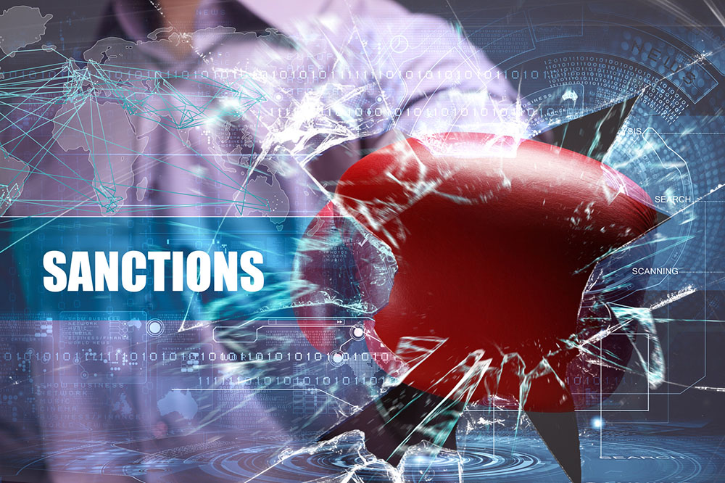
Learning objectives
What are sanctions?
Why are they used?
What are the different types of sanctions?
What are your obligations?
Our company’s sanctions policy
Notes:
In this session we’ll look at:
What are sanctions?
Why are they used?
The different types of sanctions
What are your obligations?
Our company’s sanctions policy

Slide 3
What are sanctions?
Financial or trade restrictions that stop us doing business with:
Targeted countries or regimes
Entities
Individuals
Notes:
[Ask delegates]
What are sanctions and when are they used?
Economic sanctions are financial or trade restrictions that stop us doing business with targeted countries or regimes, entities or even individuals.
Restrictions may be imposed because of international law or human rights violations, nuclear proliferation, or to target those involved in terrorism or criminality.
[Provide examples of countries or entities who currently face sanctions – for example:
1. Countries – eg Zimbabwe, Yemen, Sudan, Libya, Afghanistan, DRC, etc
2. Entities - ISIL, Tamil Tigers, Hizbul Mujahideen, etc
3. Individuals - there are currently 18 named individuals suspected of terrorist financing on the Government website, although this is continually updated]
Those targeted by sanctions include:
Drugs traffickers
Those who trade in animal parts
Russian billionaires and organisations accused of destabilising Ukraine
Charities linked to Al-Qaeda and other terrorist groups
But they're not all based overseas – some are right here in the UK, or at least some or all of their assets may be!

Slide 4
What do you think: Why are sanctions used?
To stop financial crime or terrorism
To put pressure on targeted regimes and people to change their behaviour and comply with international law
To enforce international peace and security when diplomatic efforts have failed
To suppress weaker countries and stop them becoming more powerful
✓
✓
✓
Notes:
[Ask delegates]
Why are sanctions used by the international community? What do you think?
[Allow time for reading and reflection before clicking next.]
In summary:
Sanctions are used to put pressure on targeted regimes and people to comply with international law, to stop financial crime, and to enforce international peace and security. But, they are not used to suppress weaker countries or stop them becoming powerful.
[Sanctions are not new. In fact, they have been used for thousands of years. One of the earliest was in the 5th century BC, when Pericles ordered all trade between the Athenian Empire and Megara to be banned. The reason... the city state that had sided with its enemy, Sparta.]

Slide 5
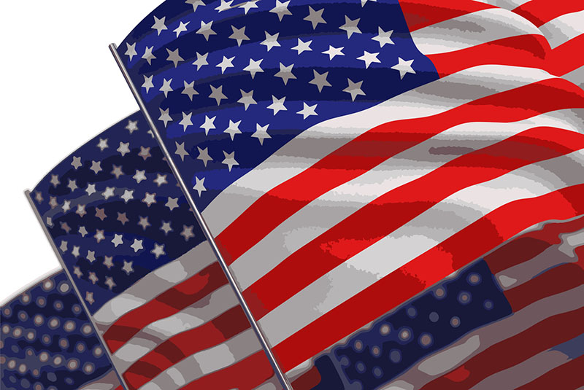
Who imposes sanctions?
The United Nations
The EU
The United States
Notes:
[Ask delegates]
So, who imposes sanctions?
Although any government can impose sanctions, the ones of most relevance to our Company are those imposed by the UN, the EU and the US.
The UN - The main aim is to maintain or restore international peace and security without the use of force - eg forcing Iran to back down from its drive to acquire nuclear weapons. In recent years, the UN has made sanctions more humanitarian - targeting rogue regimes and organisations to reduce their impact on the general population.
The UN currently imposes sanctions on Ivory Coast, Democratic Republic of the Congo, Democratic People's Republic of Korea (North Korea), Eritrea, Guinea-Bissau, Iran, Lebanon, Liberia, Libya, Somalia and Sudan.
The EU - The EU imposes sanctions and embargoes to preserve peace, strengthen international security, safeguard the security of the EU, and uphold respect for human rights, democracy and the rule of law. All Member States are obliged to implement them.
Currently the EU has restrictive measures in place against most countries on the OFAC's country sanctions programme. There are also sanctions against those who have contributed to the conflicts in the former Yugoslavian states, Haiti, Sierra Leone and Somalia, and Russian entities in relation to the Ukraine conflict.
The US - Sanctions are administered and enforced by the Office of Foreign Assets Control (OFAC) - an office within the US Treasury - to counter terrorism, illegal diamond trading, drug trafficking, nuclear proliferation and internal conflict in countries.
The OFAC currently operates comprehensive country sanctions against Belarus, Burma (Myanmar), Iran, Libya, North Korea, Somalia, Sudan, Syria and Zimbabwe; sanctions related to the Balkans, Central African Republic, Côte d'Ivoire, Democratic Republic of the Congo, Iraq, Lebanon, South Sudan and Yemen, and against Russian entities in relation to the Ukraine conflict; and against individuals and organisations (published in the Specially Designated Nationals (SDN) List).
US (OFAC) sanctions are important because the US authorities classify any company or individual, with a connection to the US, as a US person, who can be prosecuted for breaching OFAC sanctions. This could be a company with a US trading licence or US$ clearing licence, or dealing in US technology, transportation etc. The US authorities have a history of pursuing and extraditing perpetrators, and serving extremely harsh prison sentences and financial penalties.

Slide 6
Types of sanctions
Financial sanctions stop us:
Making or receiving payments
Arranging investments
Facilitating any business (e.g. broking or insurance)
Economic and Trade sanctions
A ban on exports to or imports from a jurisdiction
Restrictions on the sale of products (e.g. arms or diamonds)
Prohibitions on the supply of services
Travel restrictions on designated persons
Notes:
Financial sanctions stop us making or receiving payments, arranging investments, or facilitating any business (such as broking or insurance) that would make funds or economic resources available to designated persons.
We may also need to freeze the assets of designated persons or groups.
Economic and trade sanctions can also include:
A ban on exports to or imports from a jurisdiction
Restrictions on the sale of products - such as arms or diamonds
Prohibitions on the supply of services
Travel restrictions on designated persons

Slide 7
3 types of financial sanctions in the UK
Targeted asset freezes
Restrictions on financial markets and services (banking, insurance, brokering and advisory services)
Directions to cease all business of a specified type with a specific person, group, sector or country
Notes:
The three types of financial sanctions enforced in the UK are:
Targeted asset freezes - restricting access to funds and economic resources
Restrictions on a wide variety of financial markets and services, including banking, insurance, brokering and advisory services
Directions to cease all business of a specified type with a specific person, group, sector or country

Slide 8
Who is subject to sanctions?
Nigeria
North Korea
Al Shabaab
NO
YES
YES
Islamic State of Iraq and Syria (ISIS)
Zimbabwe
A company supplying arms to Iran
YES
YES
YES
Notes:
Who is subject to sanctions?
[Allow time for discussion before clicking next to reveal examples.]

Slide 9
When it goes wrong
ZTE Corp gets $1.1bn fine for breaching US sanctions
Standard Chartered fined $667mn for breaching US sanctions
Commerzbank AG pays $1.45bn penalty
BNP Paribas fined $9bn for sanctions breaches
Barclays pays up $2.5mn for Zimbabwe sanctions breaches
Director jailed for 30 months for supplying valves to Iran
Notes:
All too often, companies dilute the power of sanctions by breaching them.
Here are some examples of cases that have hit the headlines recently.
[As an add-on, discuss other recent cases, if required.]

Slide 10
Consequences
Substantial fines
Up to 7 years’ imprisonment (30 years in the US)
Brand and reputational damage
Notes:
Breaches of financial or trade sanctions can result in criminal prosecution, leading to imprisonment and/or fines.
If found guilty, you may face a prison sentence, ranging from up to seven years in the UK to 30 years in the US.
And, of course, negative publicity can damage our brand and reputation.

Slide 11
Tougher penalties since April 2017
“…Financial sanctions are also about maintaining the integrity of and confidence in the UK financial services sector. That is why we won’t hesitate to take robust action where a breach merits it…” Rena Lalgie, Head of OFSI
£1m
penalties for financial sanctions breaches
50%
of the value of the breach
Notes:
The stakes are getting higher too…
From April 2017, the UK Treasury’s Office of Financial Sanctions Implementation (OFSI) is able to impose penalties of up to £1m (or 50% of the breach’s value, whichever is highest) for financial sanctions breaches.
[You can learn more at:
https://www.gov.uk/government/news/new-million-pound-penalties-for-breaching-financial-sanctions]

Slide 12
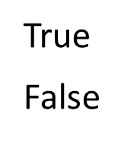
You make the call: Is it True or False?
“We process lots of low-value transactions. We can’t be expected to check everyone against sanctions.”
“Our money laundering controls are robust. That’s good enough for sanctions too.”
“Our consultancy services are free. We can’t breach sanctions if we are only giving advice.”
True
False
True
False
✓
Notes:
Look at some examples and decide whether they are True or False.
[Show each one in turn and allow delegates time to read and make a decision before clicking Next.]
Sanctions compliance is not risk-based. It requires specific steps and the obligations must be met independently.
Further, sanctions often prohibit the supply of services as well as finances. Those supplying them, as well as those conducting trade and financial transactions, can be prosecuted.

Slide 13
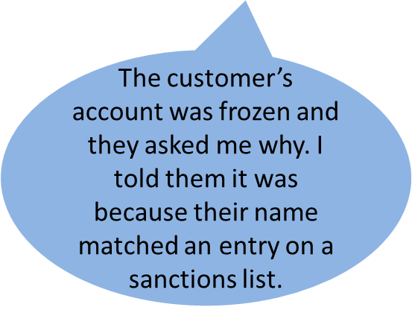
Scenario 1: Frozen out
Did she do the right thing?
Yes, she had no choice but to tell the truth
Yes, it’s OK to tell customers why their account has been frozen because sanctions lists are available publicly
No, it’s classed as a tip-off so Rebecca must refer them to the Sanctions Compliance Team instead
✓
Notes:
When a customer’s account is frozen, Rebecca is confronted with a demand to know why.
Here’s what she did.
Did she do the right thing here?
[Allow for discussion and thinking time before clicking next again]
If and when we freeze a customer’s account, they are likely to contact us to ask why.
Any such enquiry should be referred to the sanctions compliance team. In general, it is acceptable to advise the customer that their account has been frozen due to their name matching an entry on a sanctions list. Since the sanctions lists are publicly available information, this is not regarded as tipping off.
[Before delivering the session, check your own company’s policy/stance on this and amend this if required.]

Slide 14
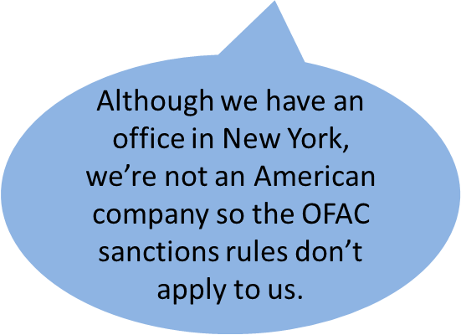
Scenario 2: Offshore office
What do you think? Is he right?
Yes, what sanctions apply is determined by the location of his company’s head office
Not sure, it depends what his company does – I’d need more information to make a decision
No, if there is a connection to the US, his company must comply with OFAC sanctions
✓
Notes:
Meet Wang. He explains his company’s stance on OFAC sanctions.
Here’s what he says.
Is he right?
[Allow for discussion and thinking time before clicking next again]
US (OFAC) sanctions are important because the US authorities classify any company or individual, with a connection to the US, as a US person, who can be prosecuted for breaching OFAC sanctions. This could be a company with a US trading licence or US$ clearing licence, or dealing in US technology, transportation etc.
The US authorities have a history of pursuing and extraditing perpetrators, and serving extremely harsh prison sentences and financial penalties.

Slide 15
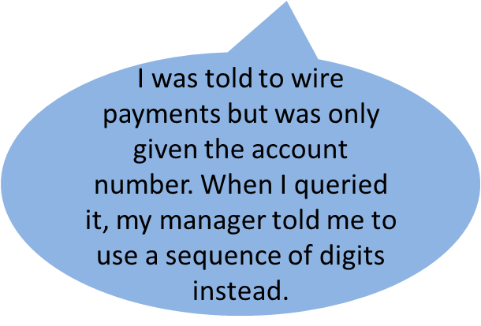
Scenario 3: Strip club
What do you think?
It’s standard practice when there is insufficient information
He should type ‘on behalf of a customer’ instead of random digits
It’s a breach of policy but since his manager okays this, it’s fine
He should report this via our whistleblowing hotline
✓
Notes:
When Richie was asked to wire a payment, he was only given the account number.
Here’s what happened next.
What do you think?
[Allow for discussion and thinking time before clicking next again]
The practice of systematically and deliberately deleting, omitting or amending information from wire payments or instructions with the aim of evading detection of sanctions targets is known as wire stripping. Several global banks have been made to pay significant fines that run into billions of dollars for using this loophole.
The following signs may suggest wire stripping:
Mismatched hash keys
Repeat sequencing of digits, spacing or characters - 'AAAA', ' ', '$#%&'
Suspicious phrases - 'No name', 'On behalf of a customer', "We only have the account number, no name', 'Can we leave out sender's name?'
All payment processing should be transparent. Under no circumstances should you change or remove - or advise customers or other organisations to change or remove - material information from payment instructions. Violating this guideline could result in disciplinary action and criminal proceedings being taken against you and us!

Slide 16
Our Sanctions Policy
Providing information and training – raising awareness
Ensuring adequate oversight and monitoring
Conducting due diligence so we don’t do business with designated persons
Maintaining records to evidence our compliance
Freezing assets belonging to sanctioned countries, entities or individuals
Reporting identified matches to the relevant authority
Applying for necessary licences before conducting business with sanctioned countries, entities or individuals
Requiring everyone to read and implement our Sanctions Policy
Notes:
Our Sanctions Policy outlines our rules, processes and procedures.
Our Company is committed to complying with all relevant sanctions by:
Providing information and training – raising awareness
Ensuring adequate oversight and monitoring
Conducting due diligence so we don’t do business with designated persons
Maintaining records to evidence our compliance
Freezing assets belonging to sanctioned countries, entities or individuals
Reporting identified matches to the relevant authority
Applying for necessary licences before conducting business with sanctioned countries, entities or individuals
Requiring everyone to read and implement our Sanctions Policy
[As an add-on, provide everyone with a copy of your Sanctions Policy and explain the key points. You might also introduce your Compliance Officer in the session giving them a 5-min slot to explain their work and offer advice.]

Slide 17
Do
Read our Company's Sanctions Policy – make sure you understand our rules and know what to do
Conduct adequate due diligence so we don’t do business with designated persons
Screen all countries, entities and individuals in line with our procedures, following up on any matches against the Sanctions Lists
Report any knowledge or suspicion of breaches promptly
Freeze any assets or funds identified as belonging to a sanctioned country, entity or individual
Notes:
We can’t do this alone. Here's what you should do:
Read our Company's Sanctions Policy – make sure you understand our rules and know what to do
Conduct adequate due diligence so we don’t do business with designated persons
Screen all countries, entities and individuals in line with our procedures, following up on any matches against the Sanctions Lists
Report any knowledge or suspicion of breaches promptly
Freeze any assets or funds identified as belonging to a sanctioned country, entity or individual

Slide 18
Don’t
Enter into any financial or trade activity with a designated person or a sanctioned regime – you will be caught
Conduct any business that you know or suspect will breach sanctions
Circumvent systems designed to detect sanction breaches – eg stripping out or changing a name, or advising a customer on how to do so or channelling transactions via another party
Ignore any match that’s flagged up
Notes:
Don't:
Enter into any financial or trade activity with a designated person or a sanctioned regime
Conduct any business that you know or suspect will breach sanctions
Circumvent systems designed to detect sanction breaches - eg stripping out or changing a name, or advising a customer on how to do so or channelling transactions via another party
Ignore any match that’s flagged up, even if you think it’s a false positive (ie a name that’s flagged which subsequently turns out not to be on the sanctions list)
Your mere presence in a country can make you subject to its laws - and that includes their sanctions. So take care to understand and comply with the rules in any country you visit on business, as well as those in your home country.

Slide 19
Questions, comments or concerns?
Notes:
Do you have any questions?

Slide 20
Next steps
Call _____ on _____ if you need information or guidance
Call _____ on _____ if you need to raise concerns
Access self-study courses on our e-learning portal for further training [or optionally – Complete your mandatory training on our corporate e-learning portal]
Notes:
You can get more help and information on this issue from these contacts.
Or, for a more in-depth look at this topic, access our self-study course.

Slide 21
About Skillcast
Skillcast provides digital learning content, technology and services to help you train your staff, automate your compliance processes and generate management reports to help you keep track of it all.
Our best-selling Compliance Essentials Library provides a complete and comprehensive off-the-shelf compliance solution for UK businesses. Register for a free trial at https://www.skillcast.com/free-trial

